Slide 1
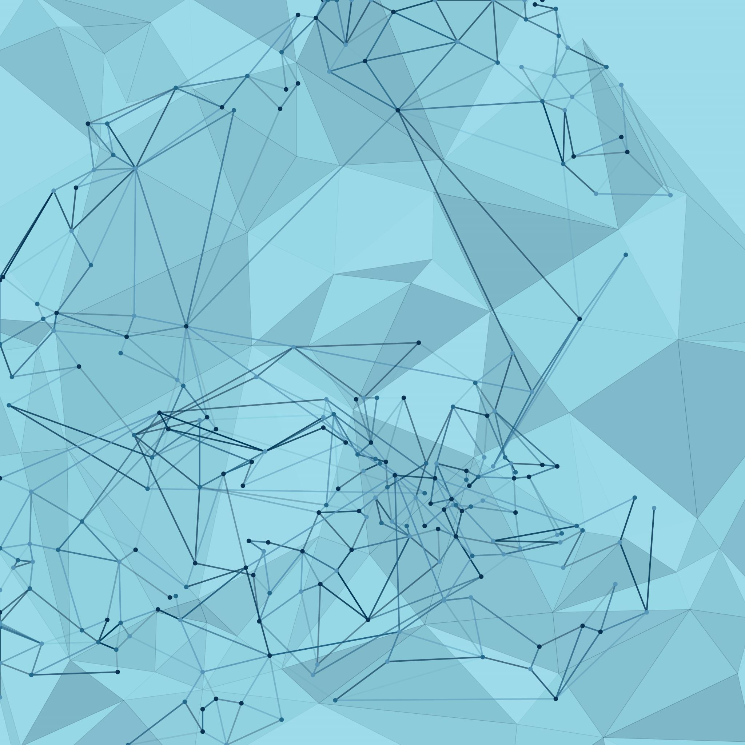
SIGNATURE VERIFICATION SYSTEM

Slide 2
OBJECTIVE:
Streamline user document management.
Verify banking, government, legal, and corporate sectors signatures efficiently.
FEATURES:
-Automated Verification
- Real time Feedback
- Signature Matching

Slide 3
Project Outline:
Frontend:
Allow users to upload or draw information interactively.
Backend:
Django - Framework provides built-in features like authentication for handling and Database management.
Python - programming language that offers libraries like NumPy, Pandas and OpenCV which can aid in signature analysis and verification.

Slide 4
Models Used :
RECURRENT NEURAL NETWORK:
Recurrent Neural Networks (RNNs) are a type of neural network architecture which is designed to handle sequential data.
Workflow :
1. Input: Dynamic signature sequence
2.Feature Extraction: Processed through LSTM layers to capture temporal dependencies.
3.Feature Representation: Final hidden state or attention output represents the signature.
4.Decision:For classification: Outputs "genuine" or "forged.“

Slide 5
Convolutional Recurrent Neural Network
A CRNN (Convolutional Recurrent Neural Network) combines Convolutional Neural Networks (CNNs) and Recurrent Neural Networks (RNNs), leveraging the strengths of both architectures
In a signature verification system, a CRNN is particularly effective for handling static (image-based) or dynamic (sequence-based) signature verification.

Slide 6
Bidirectional RNN
In a Bidirectional RNN (Bi-RNN), both forward and backward sequences are processed, capturing dependencies from both past and future inputs.
Workflow:
1.Input: Dynamic signature sequence
2.Bidirectional RNN Layer:Outputs from both directions are concatenated.
3.Feature Representation:The concatenated output is processed for final decision.
4. Output:”Genuine" or "Forged."

Slide 7
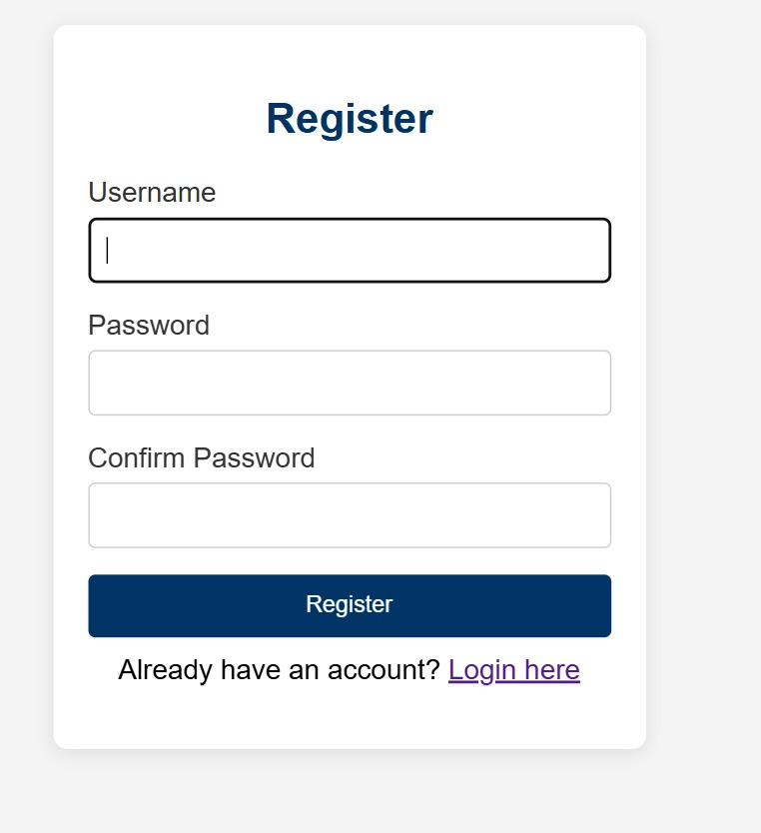
WORKFLOW OVERVIEW: User Registration

Slide 8
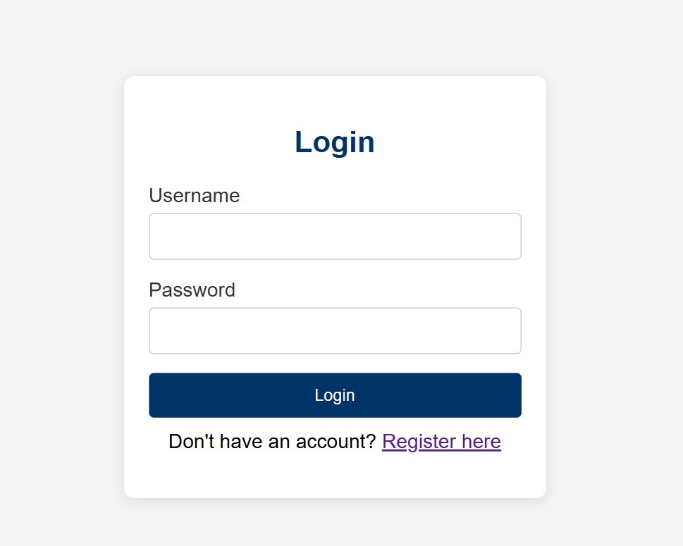
User login

Slide 9
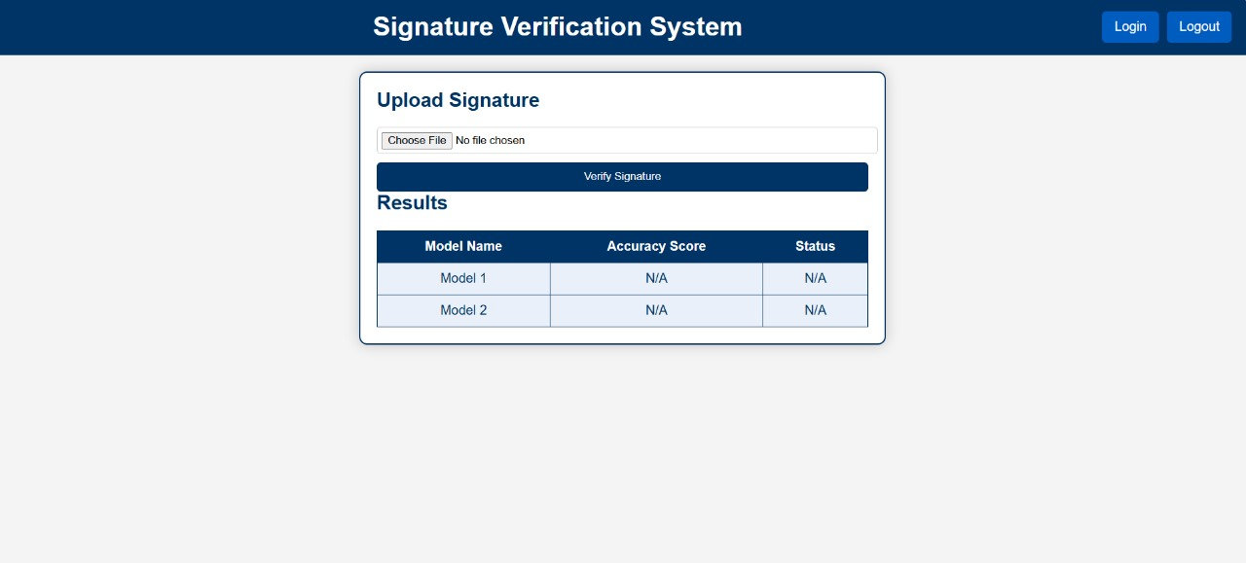
Upload Document

Slide 10
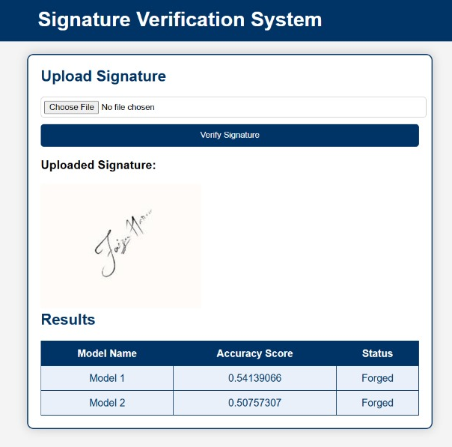
Submit & view Results

Slide 11
KEY HIGHLIGHTS:
Secure document management
Efficient signature Matching
Future Enhancements:
Expand file type support.
Integrate advanced AI for signature verification.

Slide 12
THANK YOU

